Slide 1

Introduction to Sequential Analysis
Brian Connolly, Senior Consultant Cincinnati Data and Analytics Meetup
January 17, 2023
Notes:
Cathy intro

Slide 2

Outline
Motivation
What problem is sequential analysis solving?
How does it work?
Why is sequential analysis the best solution?
Resources
Notes:
Cathy

Slide 3
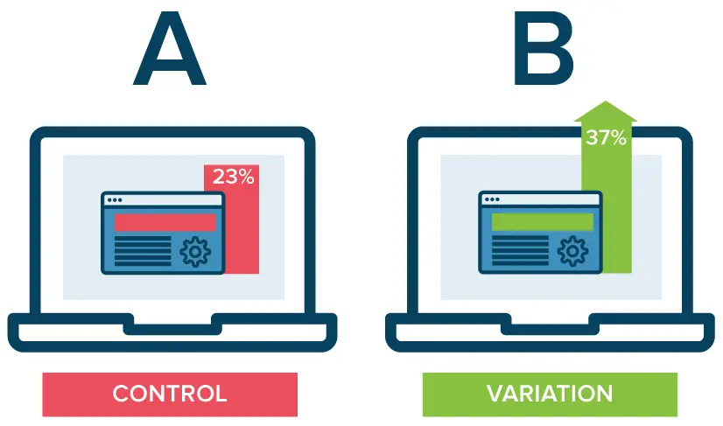
Motivation
A/B testing, at its most basic, is a way to compare two versions of something to figure out which performs better
Do this by comparing one random variable against another
Example:
Two version of a web page, A and B
Determine probability a person buying something from page A vs. page B
Notes:
Cathy

Slide 4

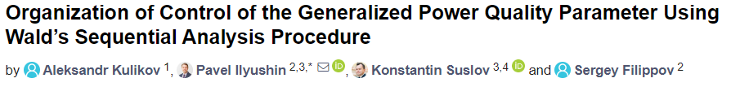
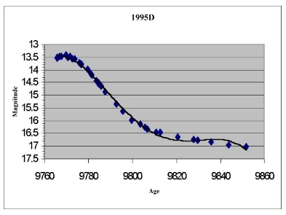

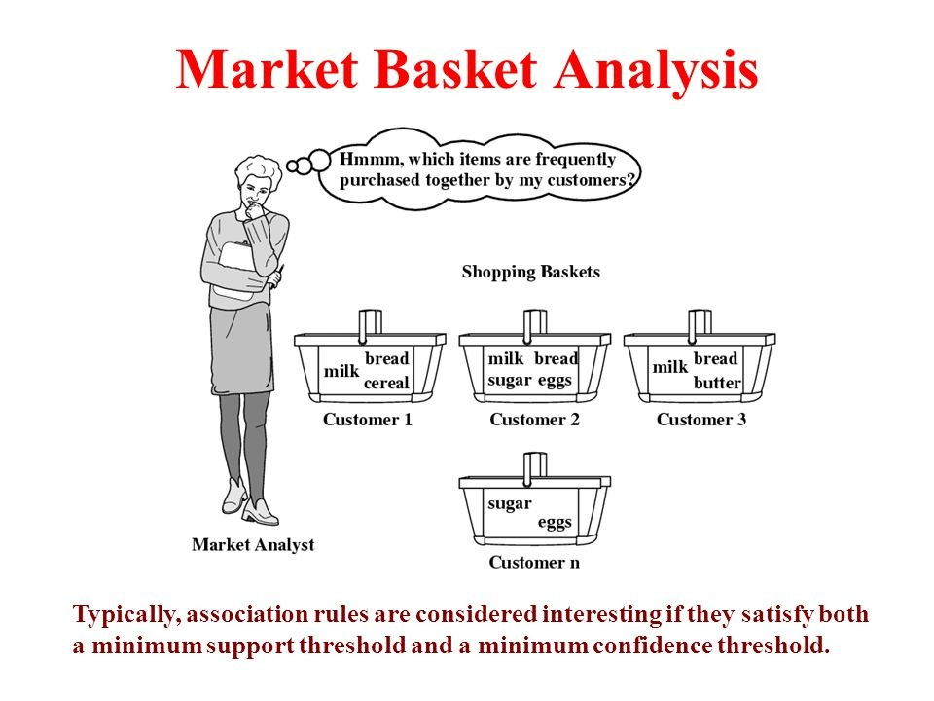

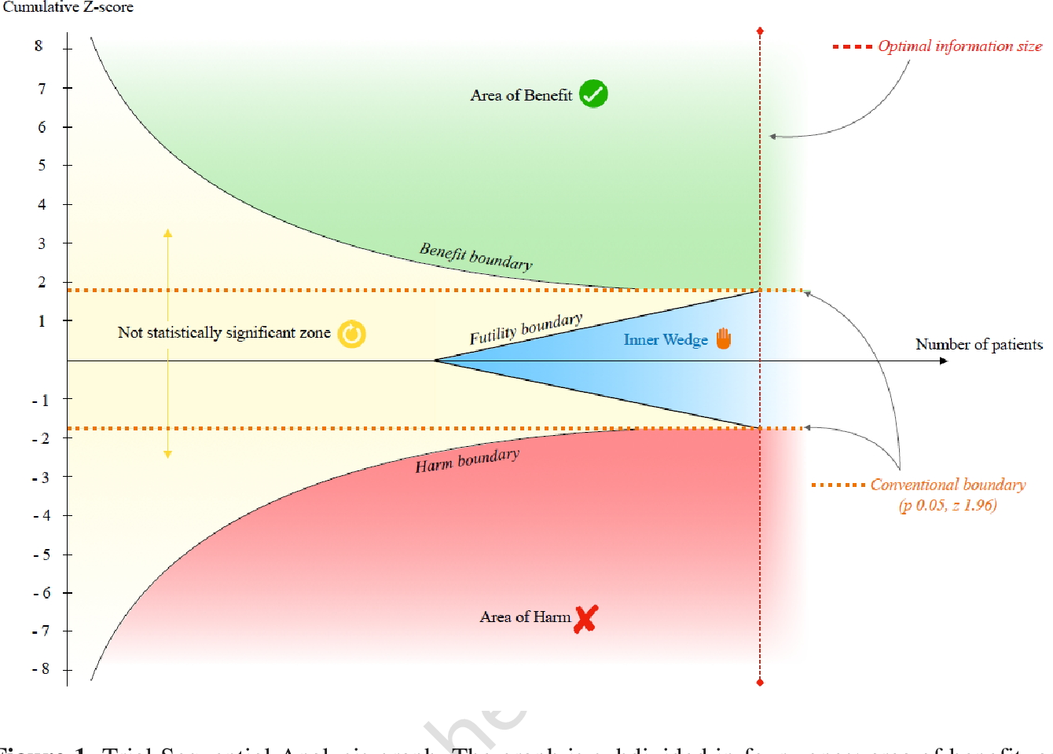
Motivation
Statistical A/B testing is used everywhere
DevOps
Marketing
Medicine
Astrophysics(!)
Statistical hypothesis testing generally falls into two categories
Traditional hypothesis testing: Determine your hypotheses, figure out how much data to take
Sequential analysis: Stop when you’ve collected enough data
Sequential analysis will remind you of control processes, but it’s not the same thing

Slide 5
More Motivation
Companies are on the lookout for statisticians to perform sequential analysis
Do not need a stats degree to be an expert
Highly in-demand skill, but easy skill to acquire if you know some statistics
Optimizely has raised $250 million dollars building an A/B testing platform that revolves around sequential analysis techniques

Slide 6


Why is Sequential Analysis So Special?
Traditional A/B Testing Methods
Determine hypothesis you want to test
Figure out how much data to take based on how willing you are to mistakenly draw the wrong conclusion
Take the data
In the end, determine whether hypothesis is supported
Disadvantages
For A/B testing, need to assume how different A will be from B
Can’t add data after the experiment is done (introducing some bias)
If stop early, left with a p-value that doesn’t provide any useful information
Sequential Analysis

Slide 7
Traditional Methods vs. Sequential Analysis
Sequential analysis solves most of the problems with A/B testing
No assumption about how different A will be from B
Can take data after the experiment is done
If stop early, have intuitive probability ratio that you can make a decision with

Slide 8

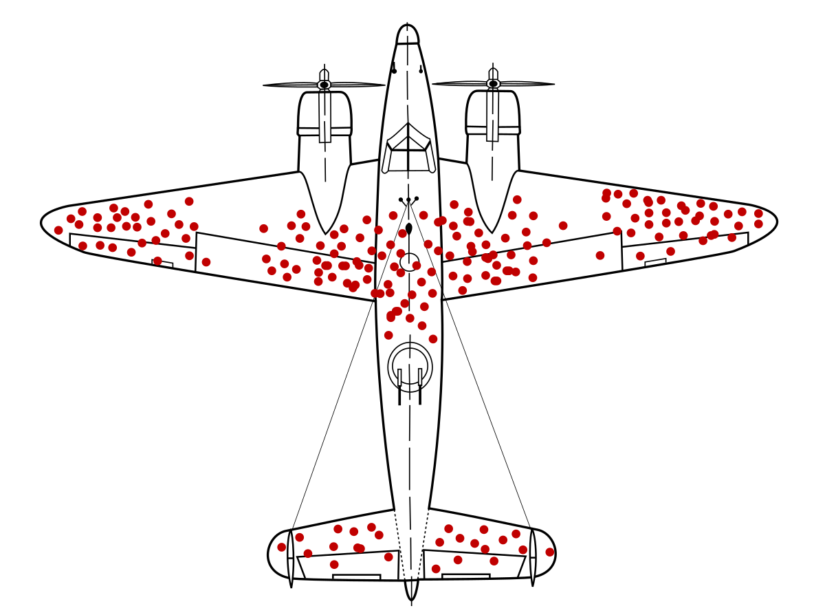
History
During WWII, the Navy was testing projectiles with 2 alternative designs
They wanted to determine which is superior.
Conducted paired firings, and assign a value of 1 or 0 based on whether performance of A was better than B
The Navy asked Milton Friedman and Allen Wallis (Statistical Research Group at Columbia University) how to determine, statistically, which was better
Friedman and Wallis couldn’t figure it out, and asked Abraham Wald, which led to development of sequential analysis technique
The rest is history
Applied to sampling bias in aircraft
Restricted access under the espionage act until 1945
Wald then wrote a paper (don’t read) and book (read)
Notes:
https://python.quantecon.org/wald_friedman.html
https://imgflip.com/gif/1ne41p
https://www.jstor.org/stable/2287451
https://www.sophiararebooks.com/pages/books/5180/abraham-wald-h-a-freeman/sequential-analysis-of-statistical-data-theory-with-sequential-tests-of-statistical
https://www.everand.com/book/271642267/Sequential-Analysis

Slide 9
HOW DOES IT WORK???

Slide 10

Sequential Analysis: The Light Bulb Factory
Doing quality assurance at light bulb factory
Want to know whether to reject a box of 25 light bulbs
Reject box if 1 or more bulbs bad
Two strategies
1. Test every light bulb in box
100% accurate
Time consuming, expensive
REJECT THIS BOX

Slide 11
Sequential Analysis: The Light Bulb Factory
Doing quality assurance at light bulb factory
Want to know whether to reject a box of 25 light bulbs
Rejected if 1 or more bulbs bad
Two strategies
1. Test every light bulb in box
100% accurate
Time consuming, expensive
2. Test a sub-set of bulbs
Decide how often you’re willing to allow the occasional bad bulb slip by
Test light bulbs until you are fairly sure the box is good
Won’t find every bad bulb
Save time, less expensive
SEQUENTIAL ANALYSIS
BOX IS PROBABLY OK, BUT THERE A CHANCE THAT I COULD BE WRONG

Slide 12

Sequential Analysis: A/B Testing
Have two versions of a web site—want to know which one produces more ad clicks
50% of traffic to website A
50% of traffic to website B
Best site is determined by probability of person clicking an ad on the site
Employ one of two test strategies
1. Use traditional A/B testing
Calculate e-customers that will be required to determine which site is better
Wait around for that number of customers and get your answer
2. Use SEQUENTIAL ANALYSIS to monitor the data in real time and end the test as soon as website clicks are statistically different

Slide 13

Sequential Analysis
Light bulb factory and website A/B testing are both forms of hypothesis testing
Hypothesis: Light bulb testing hypothesis <1 bad bulb/box
Hypothesis: A/B testing hypothesis that one website generates more clicks than the other

Slide 14
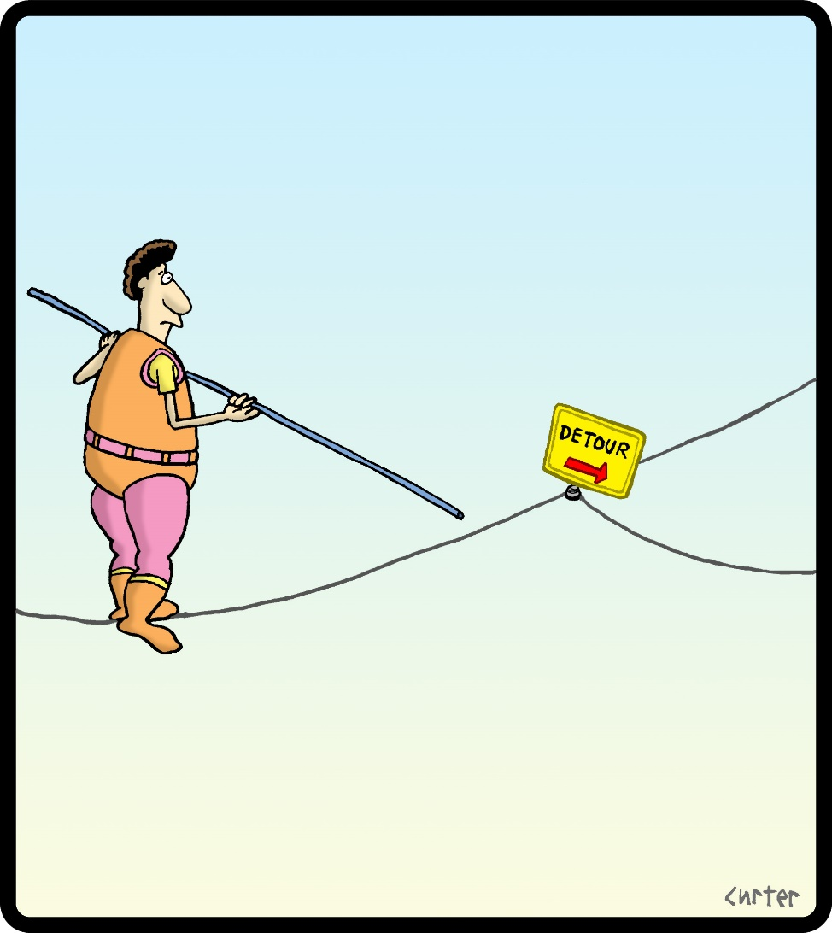
Slight Detour: Statistics Vocabulary
Null hypothesis
The ‘boring’ hypothesis
Null hypothesis is deemed true until data tells you otherwise
Alternative hypothesis
The ‘interesting’ or ‘signal’ hypothesis
Definitions of null and alternative hypotheses should be arbitrary

Slide 15
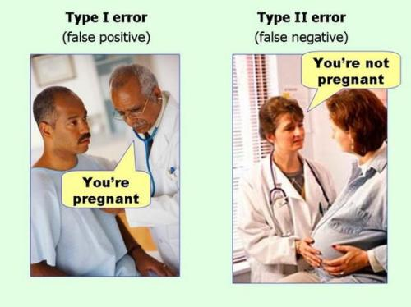
More Statistics Vocabulary
Significance level
Probability of incorrectly saying you have found a signal
Probability of incorrectly rejecting the null hypothesis
α = Τype I Error Rate
Power
Probability of finding a signal if it is there
β=1-Power = probability of incorrectly accepting null hypothesis
In hypothesis testing, power is related to how long you are willing to wait to see if there is a signal
Null Hypothesis = Not Pregnant

Slide 16
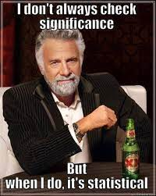
Let’s Talk Statistical Significance
“Is it significant?”
Statistical significance is not the same as importance
It is not the p-value, it is the pre-set threshold on the p-value
p-value is the chance of seeing something as extreme or more extreme than what you observed
Something is statistically significant if the p-value < significance level
Threshold is typically 5% because the statistician Ronald Fisher said so
Could be anything

Slide 17
Let’s Talk Statistical Significance
When hypothesis testing, reaching threshold is dependent on both significance and power
One way to think about it
Statistical significance governs how sure you are that you’ve found something
Power governs how long you’re willing to wait to find whether something is there
Asking whether result of test is statistically significant is much like asking whether you won the lottery – it is only half the story
You may have won, but how much did you spend to win?

Slide 18

Let’s Review What We Know So Far
Sequential analysis is used to test all kinds of hypotheses with minimal data
Statistics vocabulary
Significance level: probability of saying signal is there when there is not
Power: probability of seeing a signal if it is there
Need to set both when doing hypothesis testing

Slide 19
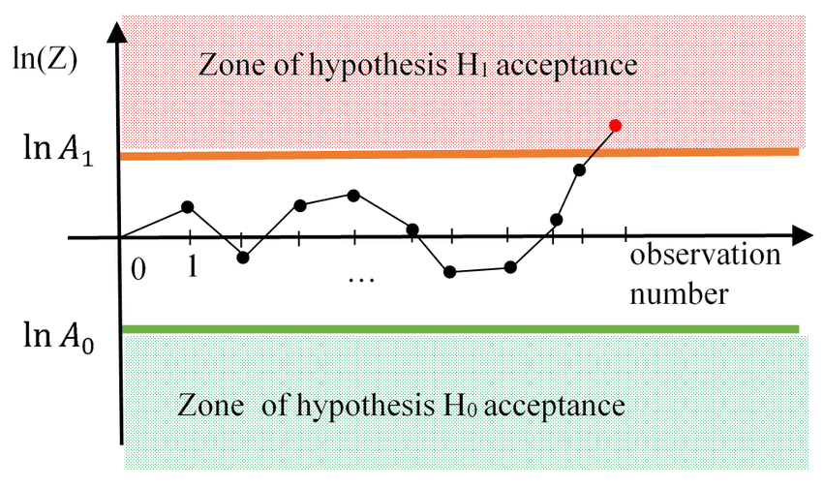
Sequential Analysis: How It Works
Determine form of statistic that will be used to evaluate how probable alternative hypothesis is over null hypothesis
R=Prob(alternative)/Prob(null)
Set significance level (how willing are you to mistakenly say you have got a signal)
Set power (how long are you willing to wait around for a signal)
Use formulas to set thresholds on R for accepting ‘signal’ hypothesis and null hypothesis
Keep recalculating R with accumulated data until you cross a threshold
Example result: “The alternative hypothesis was accepted at a 5% significance level and 80% power.”
Accept Alternative Hypothesis
R
Accept Null Hypothesis
* Notice: NO SAMPLE SIZE CALCULATION!

Slide 20
Sequential Analysis: R (likelihood ratio)
Determine form of statistic that will be used to evaluate R=Prob(alternative)/Prob(null)
Set significance level (how willing are you to mistakenly say you have got a signal)
Set power (how long are you willing to wait around for a signal)
Use formulas to set thresholds on R for accepting ‘signal’ hypothesis and null hypothesis
Keep recalculating R with accumulated data until you cross a threshold
Example result: “The alternative hypothesis was accepted at a 5% significance level and 80% power.”
Bayes Factor
Accept Alternative Hypothesis
R
Accept Null Hypothesis
* Notice: NO SAMPLE SIZE CALCULATION!

Slide 21
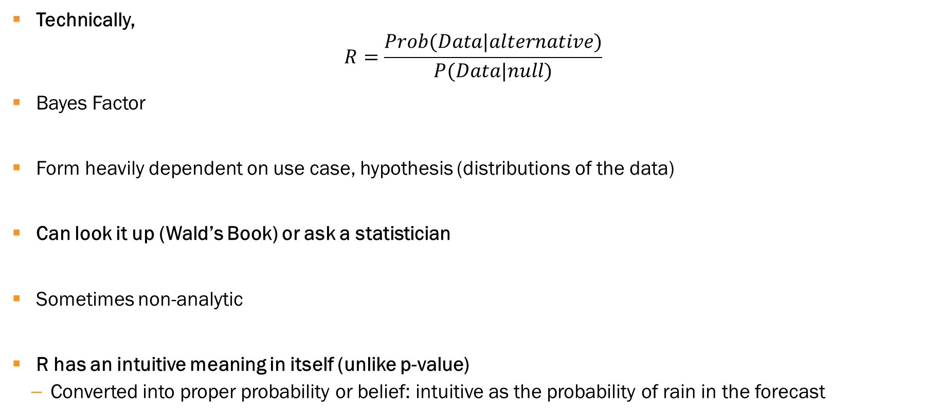
Sequential Analysis: R
Technically,
$$R=\frac{Prob(Data|alternative)}{P(Data|null)}$$
Bayes Factor
Form heavily dependent on use case, hypothesis (distributions of the data)
Can look it up (Wald’s Book) or ask a statistician
Sometimes non-analytic
R has an intuitive meaning in itself (unlike p-value)
Converted into proper probability or belief: intuitive as the probability of rain in the forecast

Slide 22
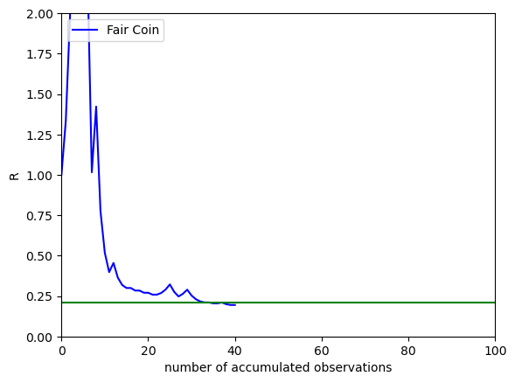
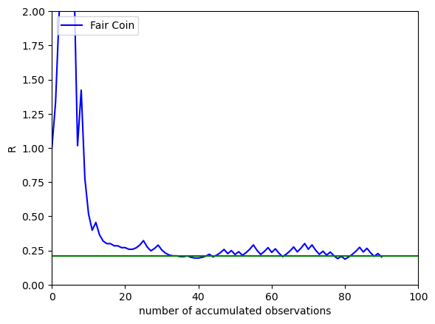
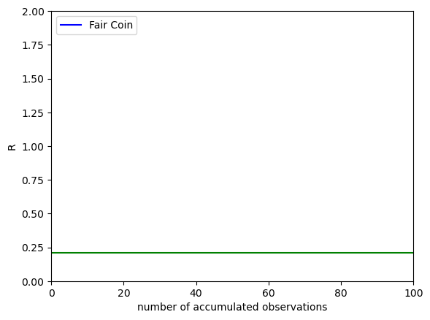

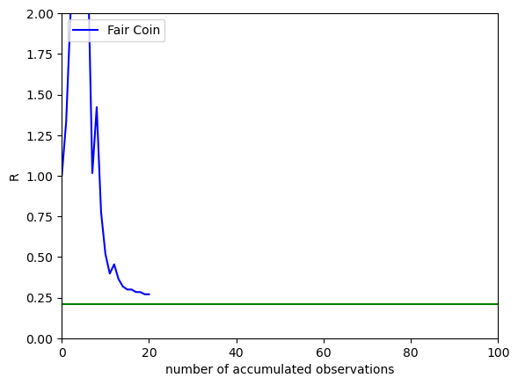
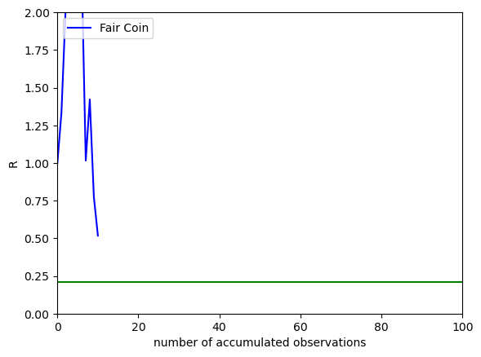
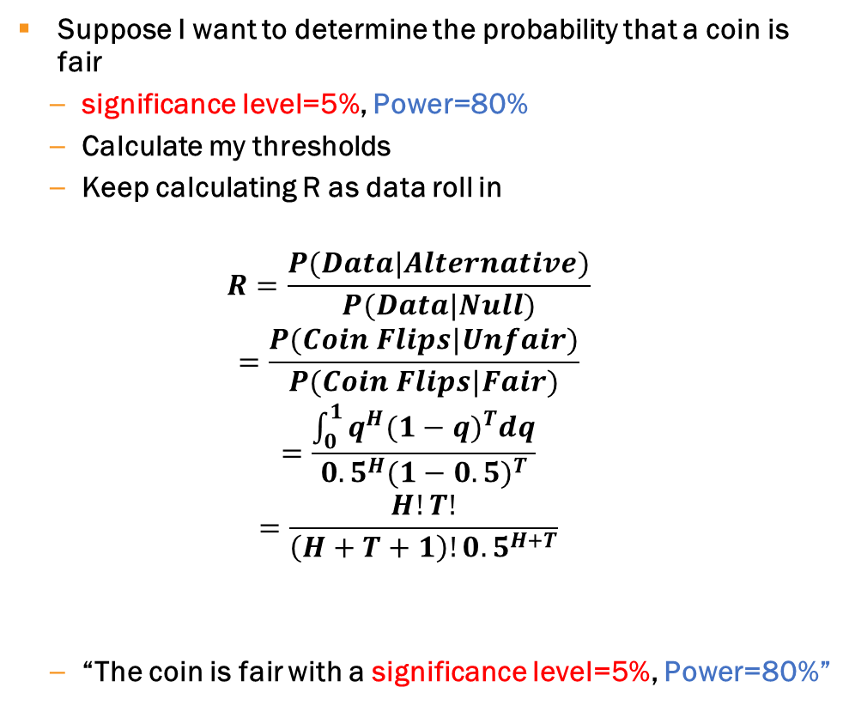
Determining Whether a Coin is Fair: A Mathematical Deep-Dive
Suppose I want to determine the probability that a coin is fair
significance level=5%, Power=80%
Calculate my thresholds
Keep calculating R as data roll in
$$R=\frac{P(Data|Alternative)}{P(Data|Null)}$$
$$=\frac{P(Coin Flips|Unfair)}{P(Coin Flips|Fair)}$$
$$=\frac{\int_{0}^{1}{q^{H}{(1−q)}^{T}dq}}{{0.5}^{H}{(1−0.5)}^{T}}$$
$$=\frac{H!T!}{\left(H+T+1\right)!{0.5}^{H+T}}$$
“The coin is fair with a significance level=5%, Power=80%”

Slide 23
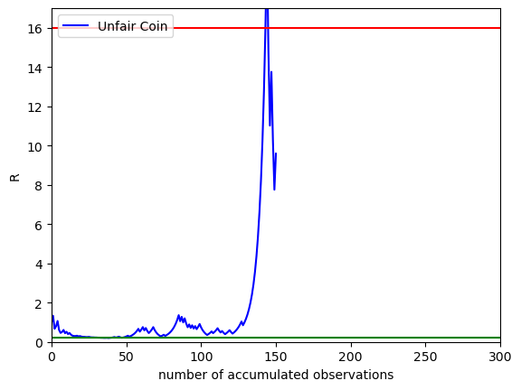
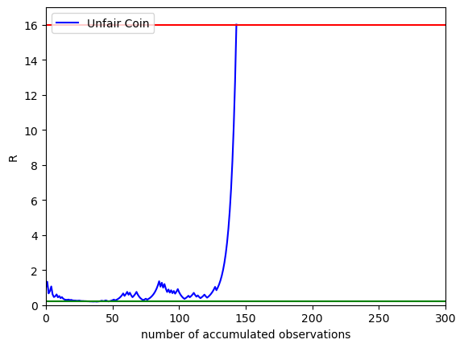
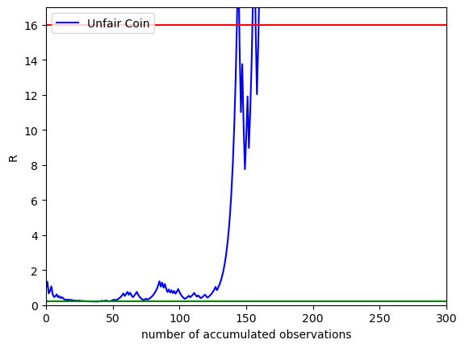
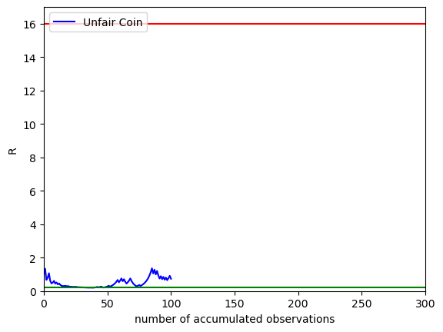
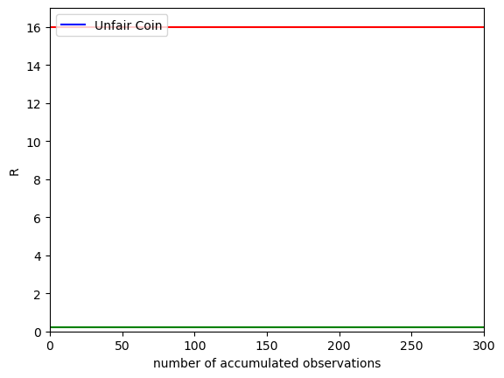
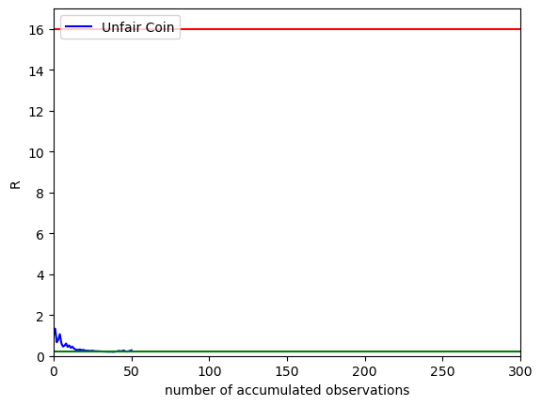
Unfair Coin
significance level=5% Power=80%

Slide 24
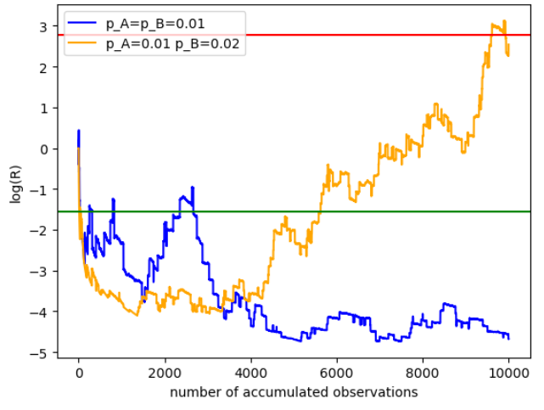
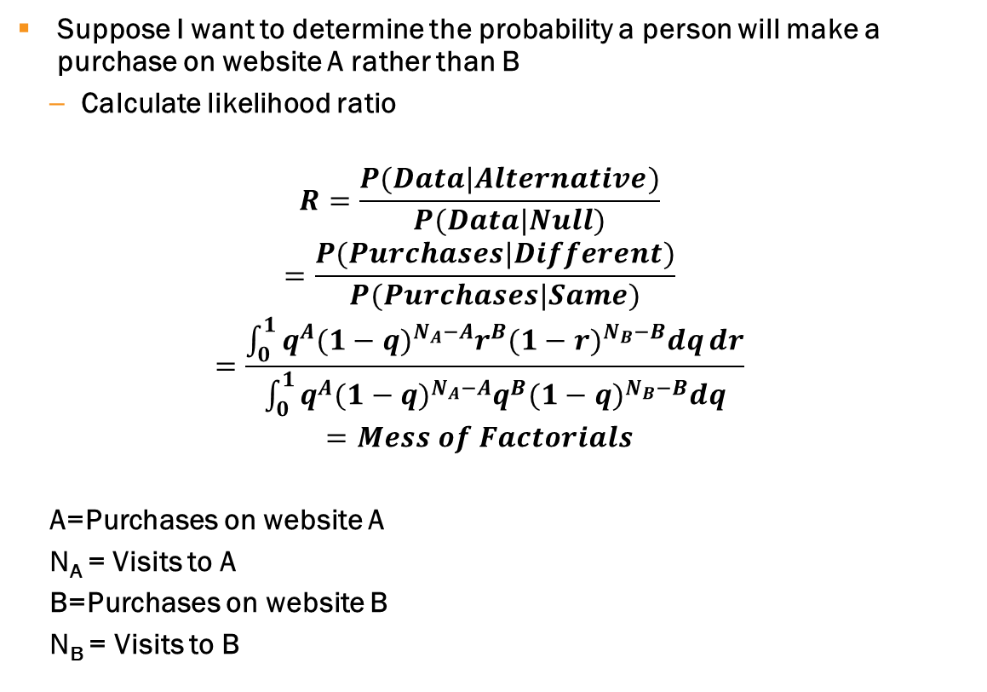
Determining Whether More Purchases on A Than B
Suppose I want to determine the probability a person will make a purchase on website A rather than B
Calculate likelihood ratio
$$R=\frac{P(Data|Alternative)}{P(Data|Null)}$$
$$=\frac{P(Purchases|Different)}{P(Purchases|Same)}$$
$$=\frac{\int_{0}^{1}{q^{A}{(1−q)}^{N_{A}−A}r^{B}{(1−r)}^{N_{B}−B}dq}dr}{\int_{0}^{1}{q^{A}{(1−q)}^{N_{A}−A}q^{B}{(1−q)}^{N_{B}−B}dq}}$$
$$=Mess of Factorials$$
A=Purchases on website A
N_{A} = Visits to A
B=Purchases on website B
N_{B} = Visits to B
Significance level = 5%
Power = 80%
* Drove traffic randomly to one or the other site

Slide 25

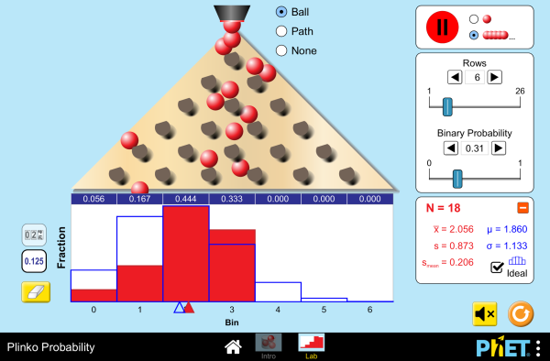
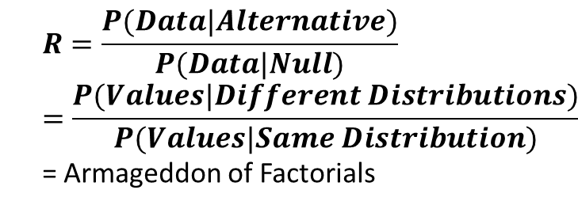
Non-Parametric Determination of Whether Two Distributions Are the Same
Suppose you want to know whether you’re reaching the same/different demographics for website A as you are for website B
Have list of ages of people who purchased from A and B
Histogramming introduces biases
Polya-tree method in Holmes, Chris C., et al. "Two-sample Bayesian nonparametric hypothesis testing." (2015): 297-320.
$$R=\frac{P(Data|Alternative)}{P(Data|Null)}$$
$$=\frac{P(Values|Different Distributions)}{P(Values|Same Distribution)}$$
= Armageddon of Factorials
Example: Connolly, Brian, et al. "A nonparametric Bayesian method of translating machine learning scores to probabilities in clinical decision support." BMC bioinformatics 18 (2017): 1-12.
Notes:
https://arxiv.org/pdf/0910.5060.pdf

Slide 26
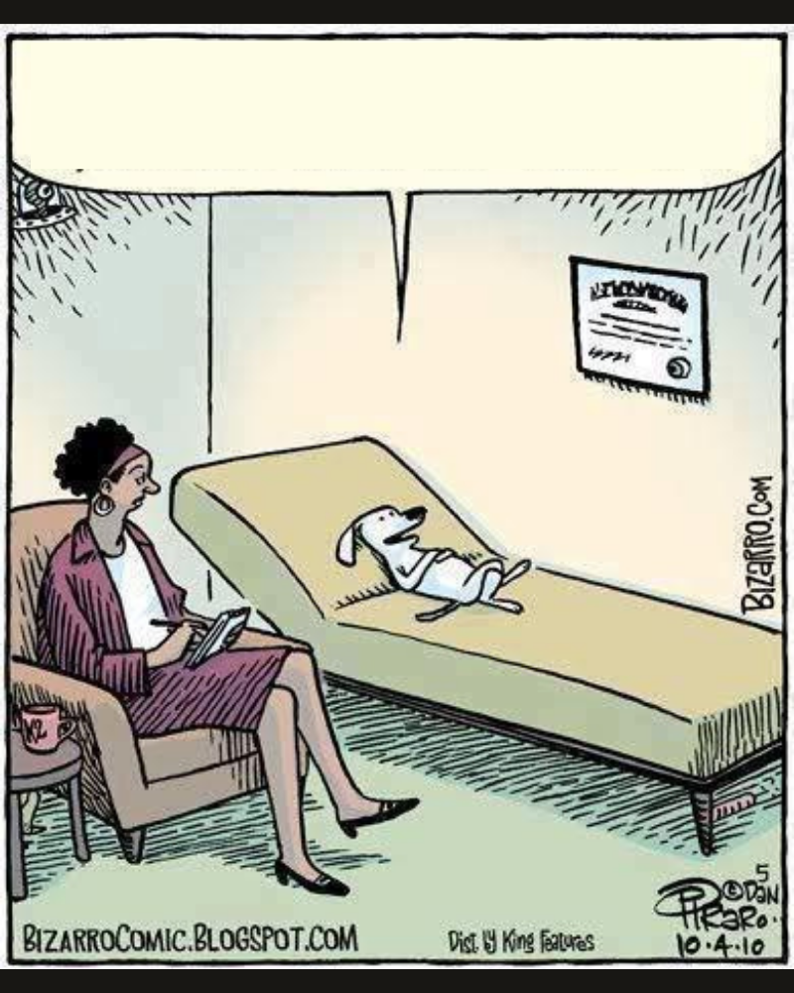
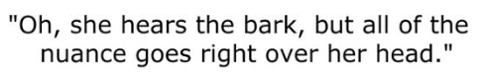
Nuances

Slide 27
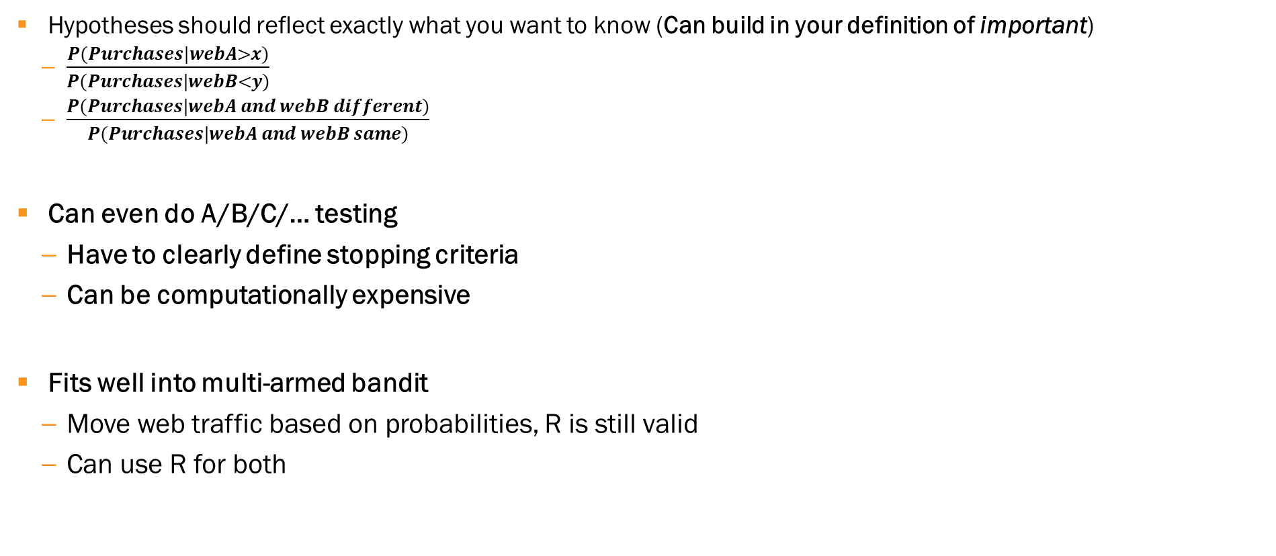
Nuances: Flexibility
Hypotheses should reflect exactly what you want to know (Can build in your definition of important)
$\frac{P(Purchases|webA>x)}{P(Purchases|webB<y)}$
$\frac{P(Purchases|webA and webB different)}{P(Purchases|webA and webB same)}$
Can even do A/B/C/… testing
Have to clearly define stopping criteria
Can be computationally expensive
Fits well into multi-armed bandit
Move web traffic based on probabilities, R is still valid
Can use R for both

Slide 28
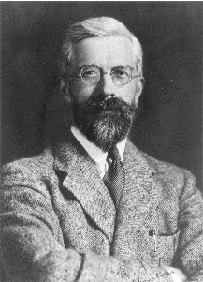
Nuances: Pragmatic Aspect
Determining significance level, power negotiation process
How much data is available
Cost/benefit
Ronald Fisher said sig. level=5%
Medicine, agriculture, sig. level=5%, power=80-90%
High energy physics, sig. level<0.000001, power not set
eCommerce: sig. level=<1%, power>99%’
5%

Slide 29
Nuances: Question from Product Managers
“Is it significant?”
Significance vs. importance
They will need some kind of estimate of sample size (with qualifier that it’s dynamic)
Performed through simulations
Requires education within the enterprise
Developer
Managers
Talks, desktop backgrounds, regular interrogations, chili cook-offs using sequential analysis to determine if there is a winner
Easy to argue for sequential analysis theoretically — can be mathematically shown to require the least amount of data
Hard to argue empirically why you should do hypothesis testing correctly — nature of A/B testing
Confidence intervals?
Be creative
Good way to quote result: “Website A was found to be better, but there’s an X% chance that I’m wrong.”
Bad way: “Website A as better”

Slide 30

Nuances: One Last Reason Why Tradition Testing is Bad
Traditional methods violate the Likelihood Principle
The information of parameters can only be extracted via the likelihood, not from experiments that could have been done
We are waiting for ‘signal’
Suppose I’m using Traditional Testing to determine whether a coin is fair and it only requires 3 heads and 5 tails for the test to end
Suppose then that it ends with 3 heads and 5 tails
Suppose then an alien arrives and finds some coin flipping data, and calculates the likelihood of obtaining 3 heads and 5 tails
The alien and I will calculate different values for the likelihood
I know that I stopped at 3
Alien assumes there can be up to 8 heads
Only problem with traditional (frequentist) approach, no problem if using sequential analysis (probability theory)
3 heads
5 tails
Notes:
https://statmodeling.stat.columbia.edu/2020/12/18/the-likelihood-principle-in-model-check-and-model-evaluation/
https://bookdown.org/aramir21/IntroductionBayesianEconometricsGuidedTour/sec24.html
https://math.stackexchange.com/questions/452218/negative-binomial-distribution-deriving-of-the-p-m-f-combinatorially#:~:text=Negative%20binomial%20distribution%20%2D%20deriving%20of%20the%20p.m.f.%20combinatorially,-Ask%20Question&text=Let%20X%20be%20the%20number,(1%E2%88%92p)x.

Slide 31
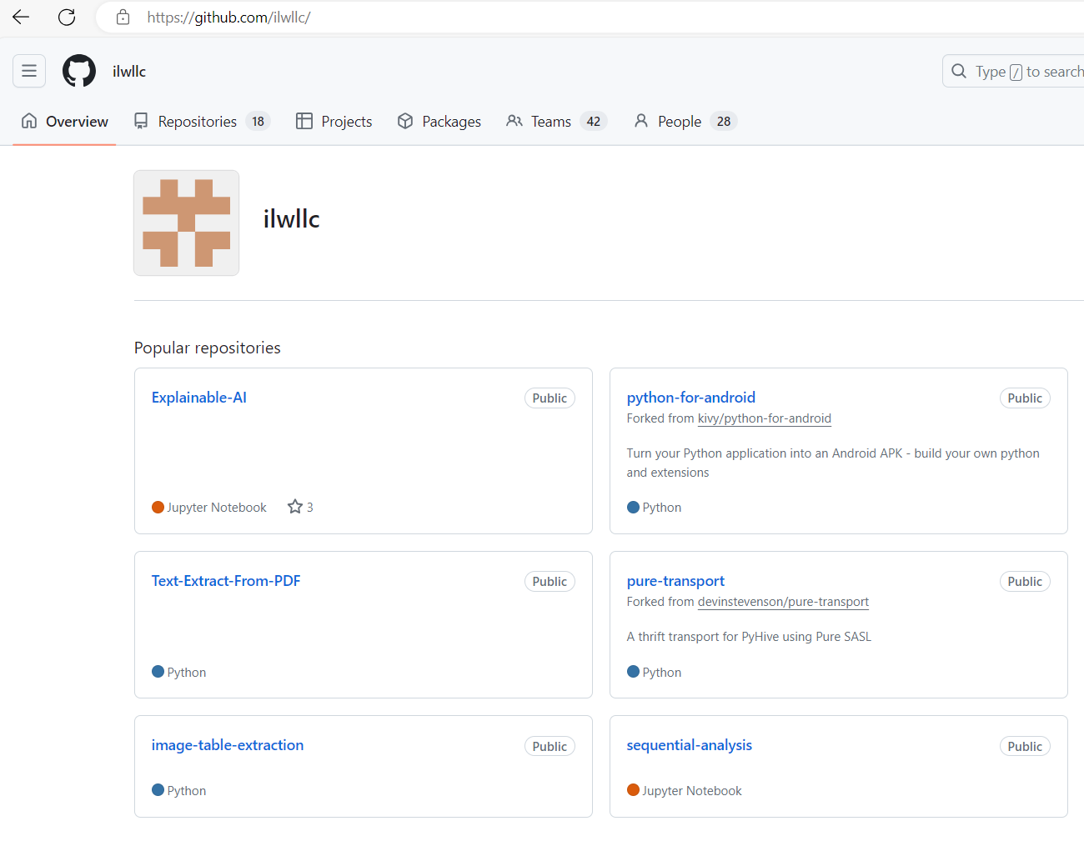
Jupyter Notebook Demo
github.com/ilwllc
Includes
Simple A/B website test example
Various wrapper functions, including Bayesian t-Test

Slide 32
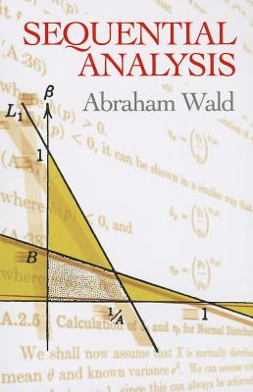
Resources
Jupyter notebook
Wald book (don’t read his paper)
Statistics Cheat Sheet
General References
https://www.semanticscholar.org/paper/Trial-sequential-analysis%3A-plain-and-simple-Cassai-Pasin/b14fead297fb7c4dc57f79c8d5ee082ae85485f4
https://apps.dtic.mil/sti/trecms/pdf/AD1184407.pdf
https://blog.analytics-toolkit.com/2017/the-bane-of-ab-testing-reaching-statistical-significance/
Neat Stuff About Wald/Friedman’s Work During WWII
https://tomtunguz.com/clandestine-statisticians/
https://julia.quantecon.org/dynamic_programming/wald_friedman.html
Statistical Significance
https://www.ncbi.nlm.nih.gov/books/NBK459346/
P-values are bad
http://www.dcscience.net/Sellke-Bayarri-Berger-calibration-of-P-2001.pdf
https://www.nytimes.com/2011/01/11/science/11esp.html
Donald Barry clinical papers
Technical Report 418 Interim Analyses in Clinical Trials_ Classical vs ad hoc vs Bayesian Approaches Donald A Berry.pdf (umn.edu)
Berry DA (1993). A case for Bayesianism in clinical trials (with discussion). Stat Me
Optimizely white paper
https://www.optimizely.com/contentassets/9205a8a811e84957a7cca527d4af20be/whitepaper_optimizely_stats_engine.pdf/download

Slide 33

Summary
Discussed what Sequential Analysis is and why it is a powerful tool for hypothesis testing
Best way to learn Sequential Analysis is by applying it to real world use case
Provided resources where you can learn more
Sequential Analysis is a valuable tool; not many people are experts, but it is easy to master

Slide 34


Q&A

Slide 35
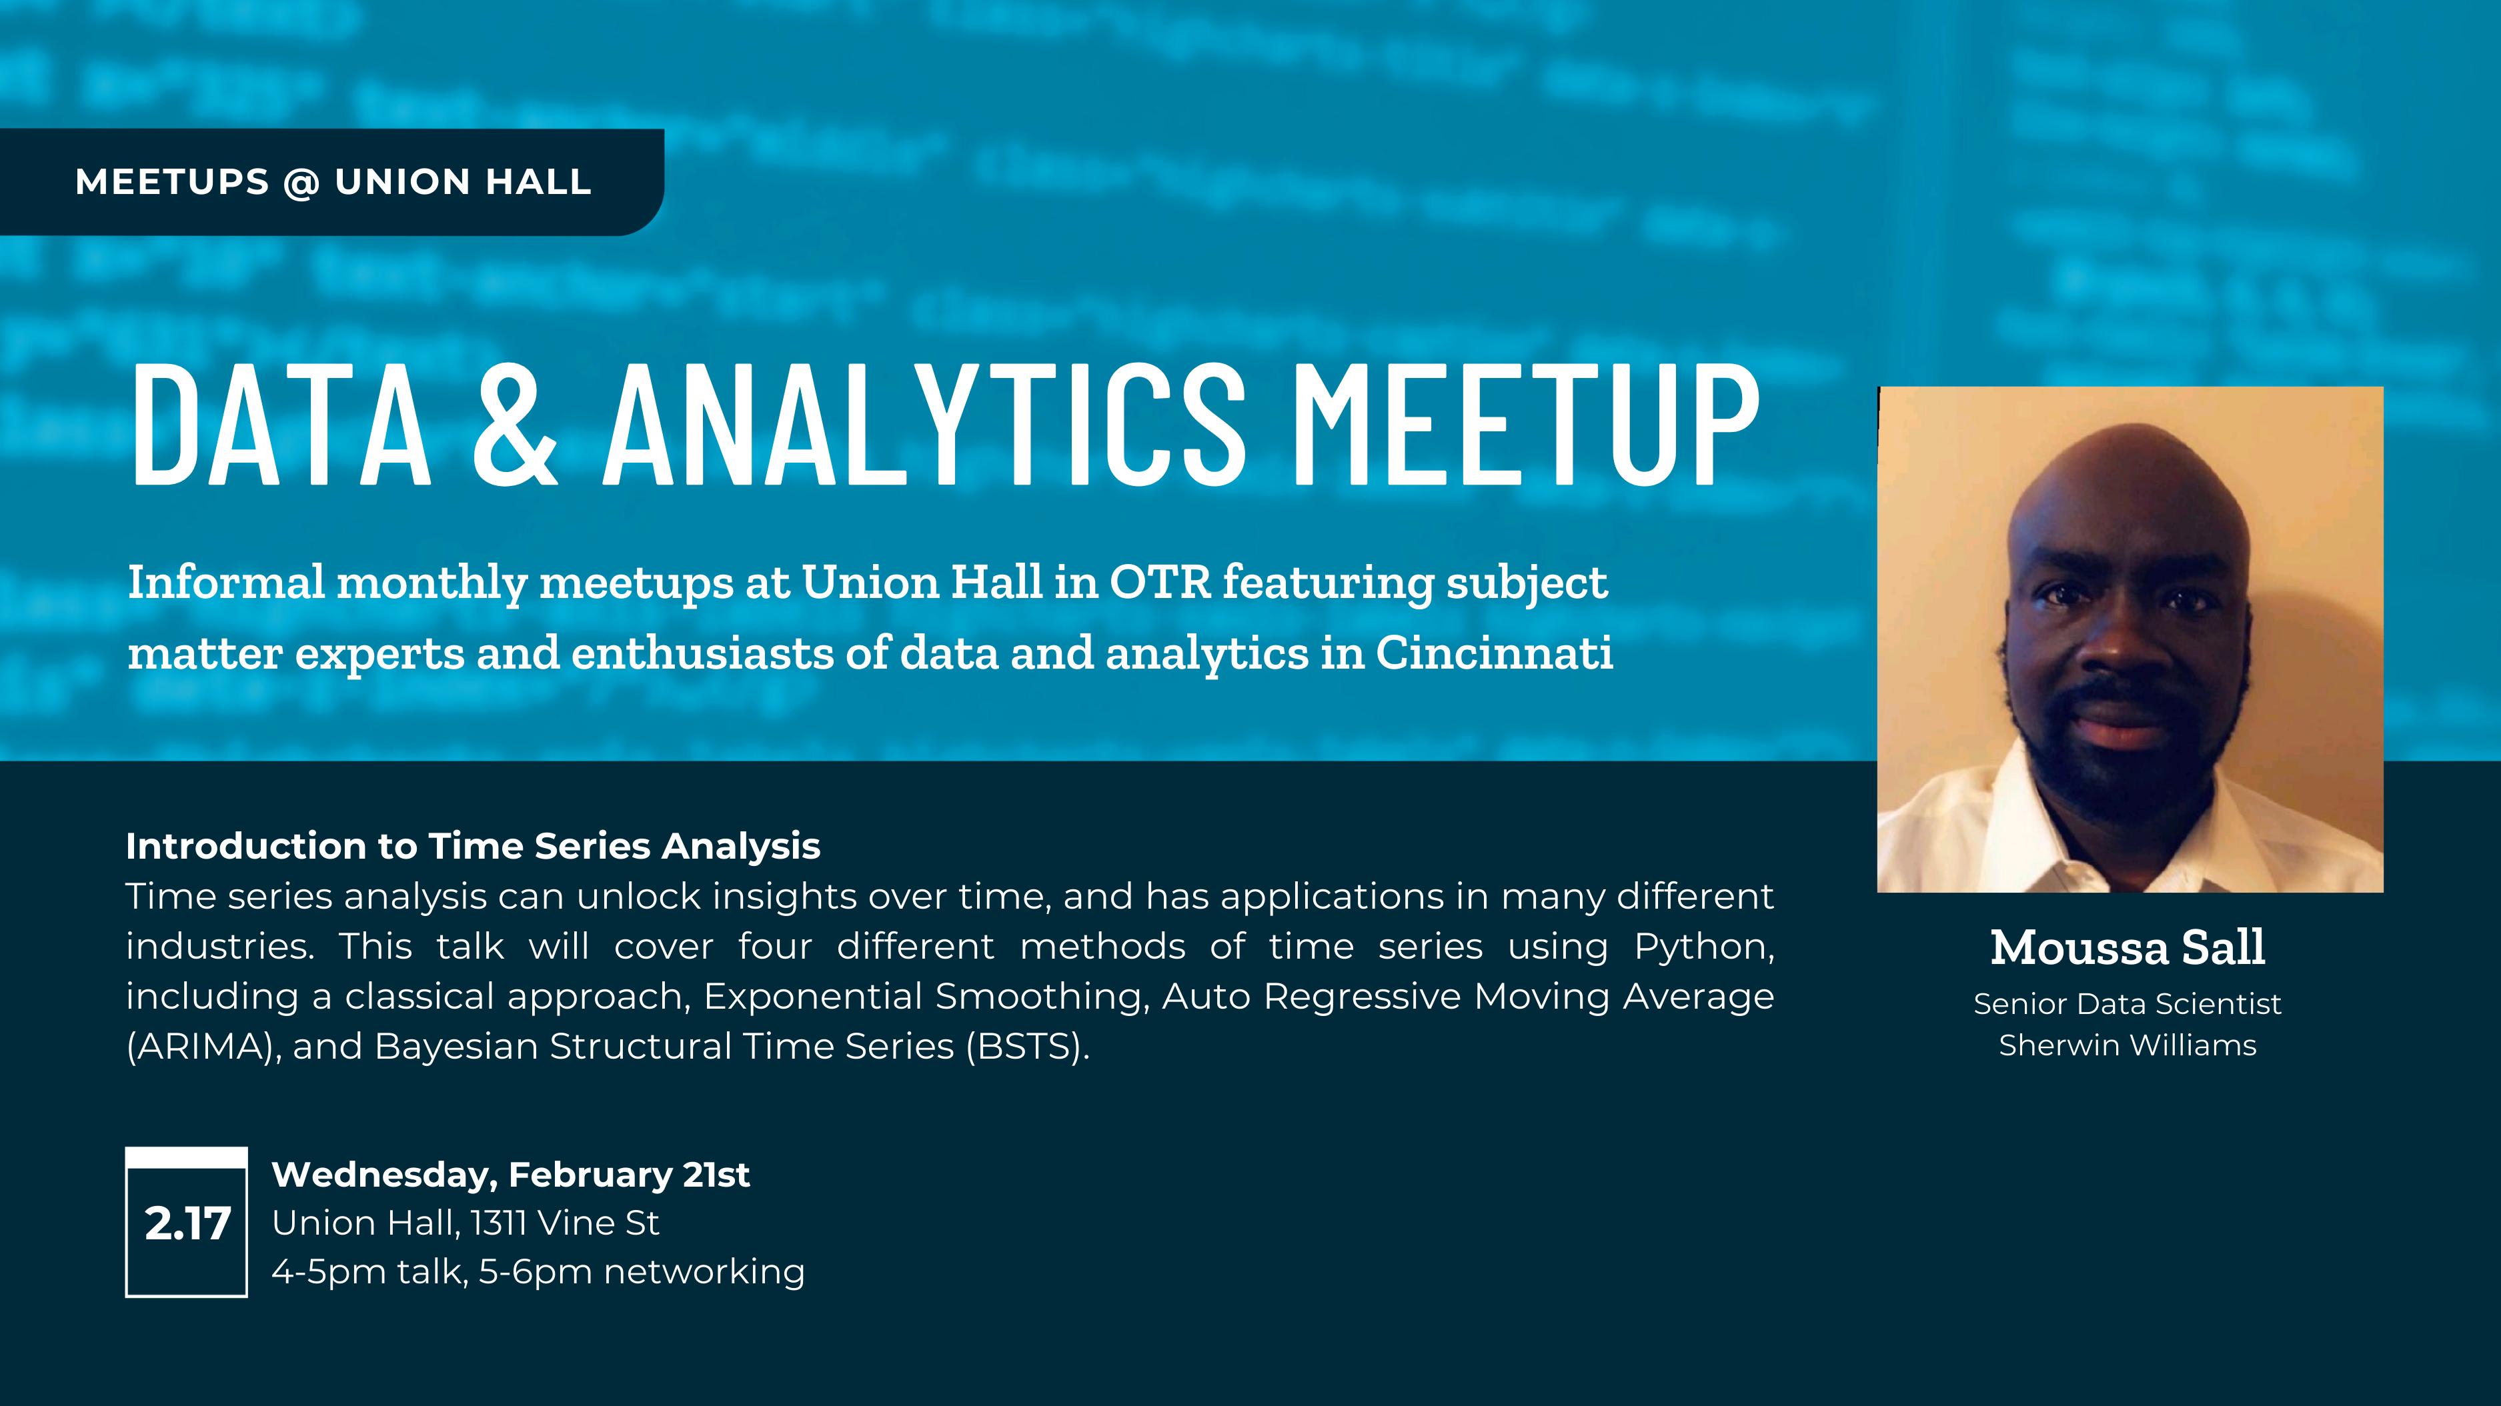

Slide 36
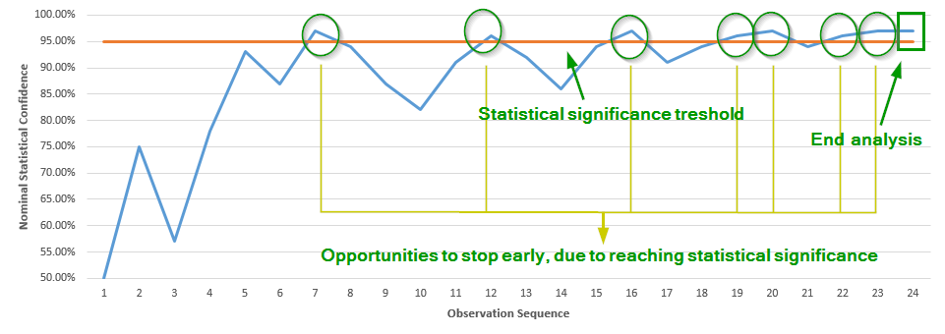
Traditional A/B Testing Revisited
Basically, follows same procedure BUT…
Calculate amount of data you need to take before test (sample size calculation)
LOCKED INTO TAKING THAT AMOUNT OF DATA
Use P-values instead of R
P-value: “The probability of obtaining a result that is as extreme or more extreme than the value that was observed.”
Many problems with traditional testing
Cannot terminate test prematurely
Cannot add data when test is over
P-value does not mean anything by itself
Have to know a lot about how data is distributed, what expected result will be
Violates likelihood principle
P-value
Number of Observations ‘Tuned’ Through Power

Slide 37
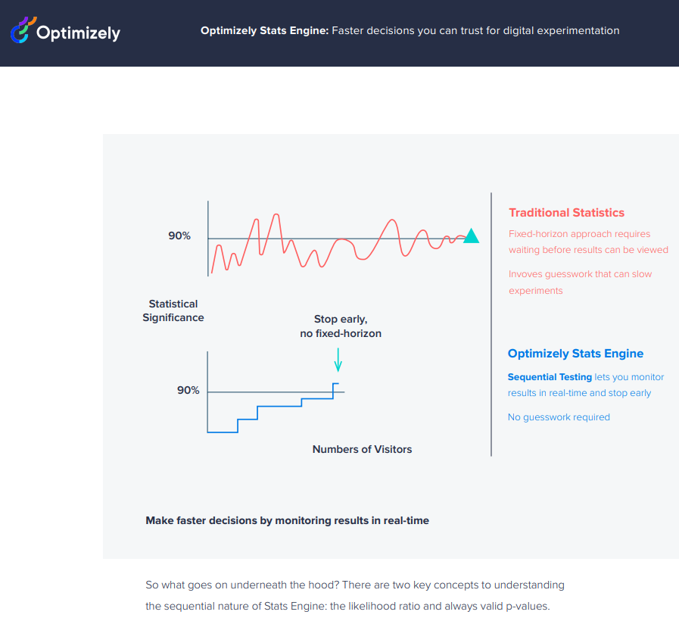
Motivation: Optimizely
First tried to differentiate themselves by claiming to do something different
Partnered with “Stanford Statisticians”
“Mixture Likelihood Ratio”
Extension of Sequential Analysis technique
Never, ever do this
Nothing valid about p-vales
Notes:
https://www.diva-portal.org/smash/get/diva2:1323628/FULLTEXT01.pdf - SEQUENTIAL A/B TESTING USING PRE-EXPERIMENT DATA by Erik Stenberg
https://www.tandfonline.com/doi/pdf/10.1080/00949655.2012.732578

Slide 38
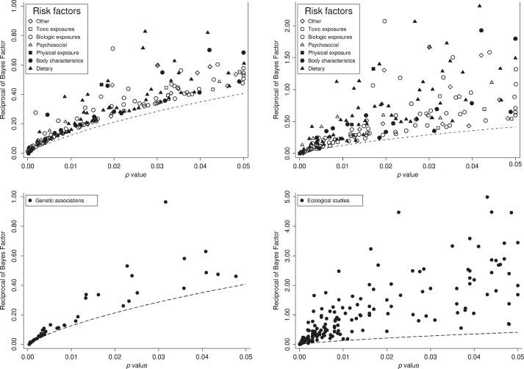
P-Values
“Change of measuring a value that is as extreme for more extreme than the value that you have measured assuming the null hypothesis is true”
Not a proper probability
Mathematically, it has no value
Does include the chance that the alternative hypothesis is true
Sellke, Thomas, M. J. Bayarri, and James O. Berger. "Calibration of ρ values for testing precise null hypotheses." The American Statistician 55.1 (2001): 62-71.
Empirically, some correlation with proper probability
These figures show the relationship between the p-value and the reciprocal of the estimated Bayes factor, 1/Rpost, for results that were statistically significant (p<0.05) across a range of scientific fields. In each figure, the dashed line shows the reciprocal of the Bayes factor bound (−eplogp), which is a lower bound for the reciprocal of the Bayes factor. The top two panels graph 1/Rpost versus the p-value for 272 epidemiological studies; 1/Rpost is estimated assuming a relative risk under the alternative of 1.65 in the first panel and 4.48 in the second panel. The lower left panel gives the same for 50 genetic associations; 1/Rpost is estimated assuming a relative risk under the alternative of 1.44 (the median observed across the genetic associations). The last panel graphs 1/Rpost versus p-values for 202 articles published in the journal Ecology in 2009; 1/Rpost is estimated assuming a standardized effect size under the alternative drawn from Uniform[−6,6]. This distribution was used in previous work (Sellke et al., 2001), which found that Bayes factor calculations were fairly robust to alternative plausible distributions. The first three panels are Figures 1–3 from Ioannidis (2008). The last panel is an edited version of Figure 4a from Elgersma and Green (2011); of the 308 articles included in the data for that paper, we dropped 6 articles with a p-value greater than 0.05, and we dropped 6 additional articles with 1/Rpost greater than 5 in order to make the figure more readable.
Bayarri, M. J., et al. "Rejection odds and rejection ratios: A proposal for statistical practice in testing hypotheses." Journal of Mathematical Psychology 72 (2016): 90-103.
Notes:
https://www.sciencedirect.com/science/article/abs/pii/S0895435611000096
https://www.researchgate.net/figure/These-figures-show-the-relationship-between-the-p-value-and-the-reciprocal-of-the_fig4_288890481
https://www.sciencedirect.com/science/article/pii/S002224961600002X

